Slide 1


JOIN THE INCLUSION REVOLUTION

Slide 2
Start your presentation with a video. Choose one of the following and embed it on this slide:
Austin found his power 3:40 <iframe width="560" height="315" src="https://www.youtube.com/embed/D_XgAyyYjjk" title="YouTube video player" frameborder="0" allow="accelerometer; autoplay; clipboard-write; encrypted-media; gyroscope; picture-in-picture; web-share" allowfullscreen></iframe>
Changing the World Through Sport 2:41 <iframe width="560" height="315" src="https://www.youtube.com/embed/Vc17w3WVWPA" frameborder="0" gesture="media" allow="encrypted-media" allowfullscreen></iframe>
Get Involved 2:29 <iframe width="560" height="315" src="https://www.youtube.com/embed/jyA3jvAUaPk" frameborder="0" gesture="media" allow="encrypted-media" allowfullscreen></iframe>
Be a Game Changer 1:44 <iframe width="560" height="315" src="https://www.youtube.com/embed/VIzgPIWuc4U" frameborder="0" gesture="media" allow="encrypted-media" allowfullscreen></iframe>
How to embed a video in Power Point:
Click the slide that you want to add a video to. (THIS SLIDE)
Choosing from one of the videos above, copy and past the video embed code (red text) of the video you would like to use.
On the Insert tab, click Video > Online Video.
Past the embed code in the From a Video Embed Code option.
A video rectangle is placed on your slide, which you can move and resize as you like. To preview your video on your slide, right-click the video, and then click Preview.

Slide 3
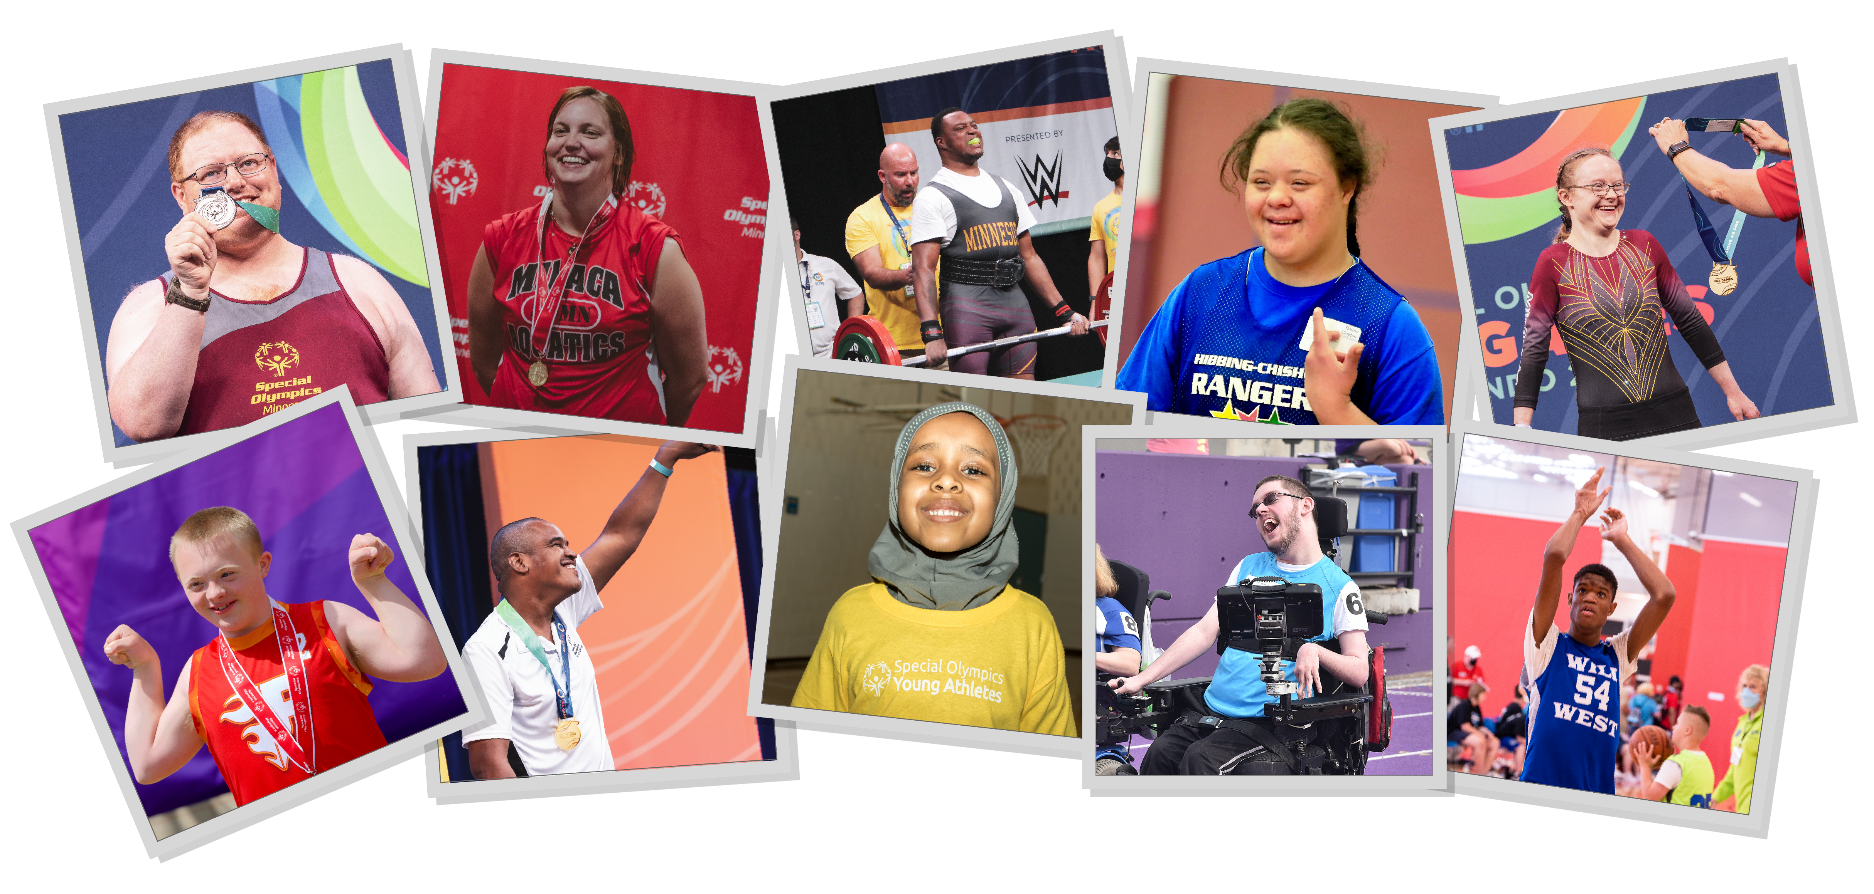
MISSION
Special Olympics Minnesota’s mission is to create a new world of inclusion and acceptance for people with intellectual disabilities. We do this by providing year-round sports training and athletic competitions, inclusive healthcare programs, leadership and advocacy training, and inclusive school programs.
GET INVOLVED

Slide 4
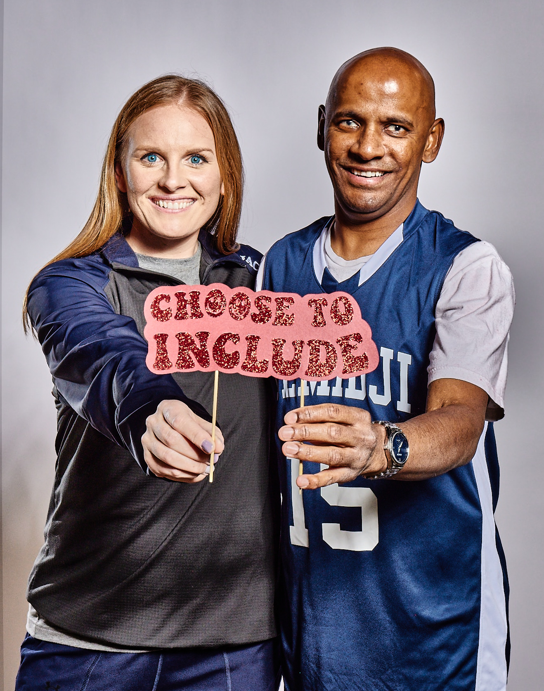

VOLUNTEER FOR
SPECIAL OLYMPICS MINNESOTA
Volunteers are the backbone of
Special Olympics Minnesota, and we’re looking
for more people to join our team.
Notes:
[Why did you get involved with Special Olympics Minnesota?]
[How has your involvement with Special Olympics Minnesota impacted your life?]
[What is the volunteer need on your team?]

Slide 5
3 MYTHS ABOUT
SPECIAL OLYMPICS MINNESOTA
Special Olympics is just one track & field event in the summer.
Coaching a Special Olympics team is a big responsibility.
You have to be a sports expert to volunteer for a Special Olympics team.

Slide 6
3 MYTHS ABOUT
SPECIAL OLYMPICS MINNESOTA
Special Olympics is just one track & field event in the summer.
Coaching a Special Olympics team is a big responsibility.
You have to be a sports expert to volunteer for a Special Olympics team.
TRUTH:
TRUTH:
TRUTH:
Special Olympics Minnesota hosts throughout the year and across the state. From bocce ball to bowling to flag football to golf, there is something for everyone.
Sure, being a Special Olympics coach requires dedication, but you won’t have to do it alone! Share the responsibilities with support from the state office, other coaches, team assistants and volunteers. There are no limitations to your coaching staff.
The requirements for most Special Olympic volunteer roles just require enthusiasm and positivity to create a fun environment for everyone!

Slide 7
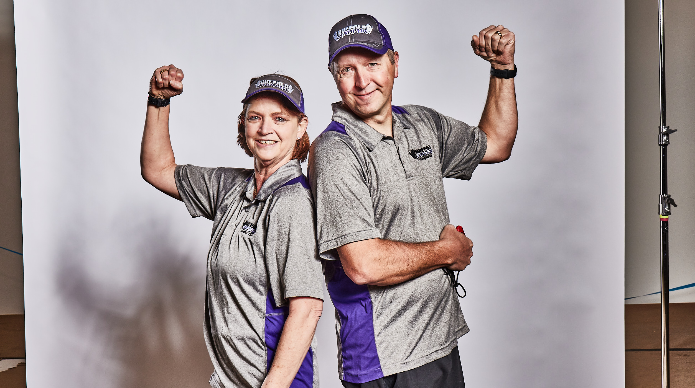

Slide 8
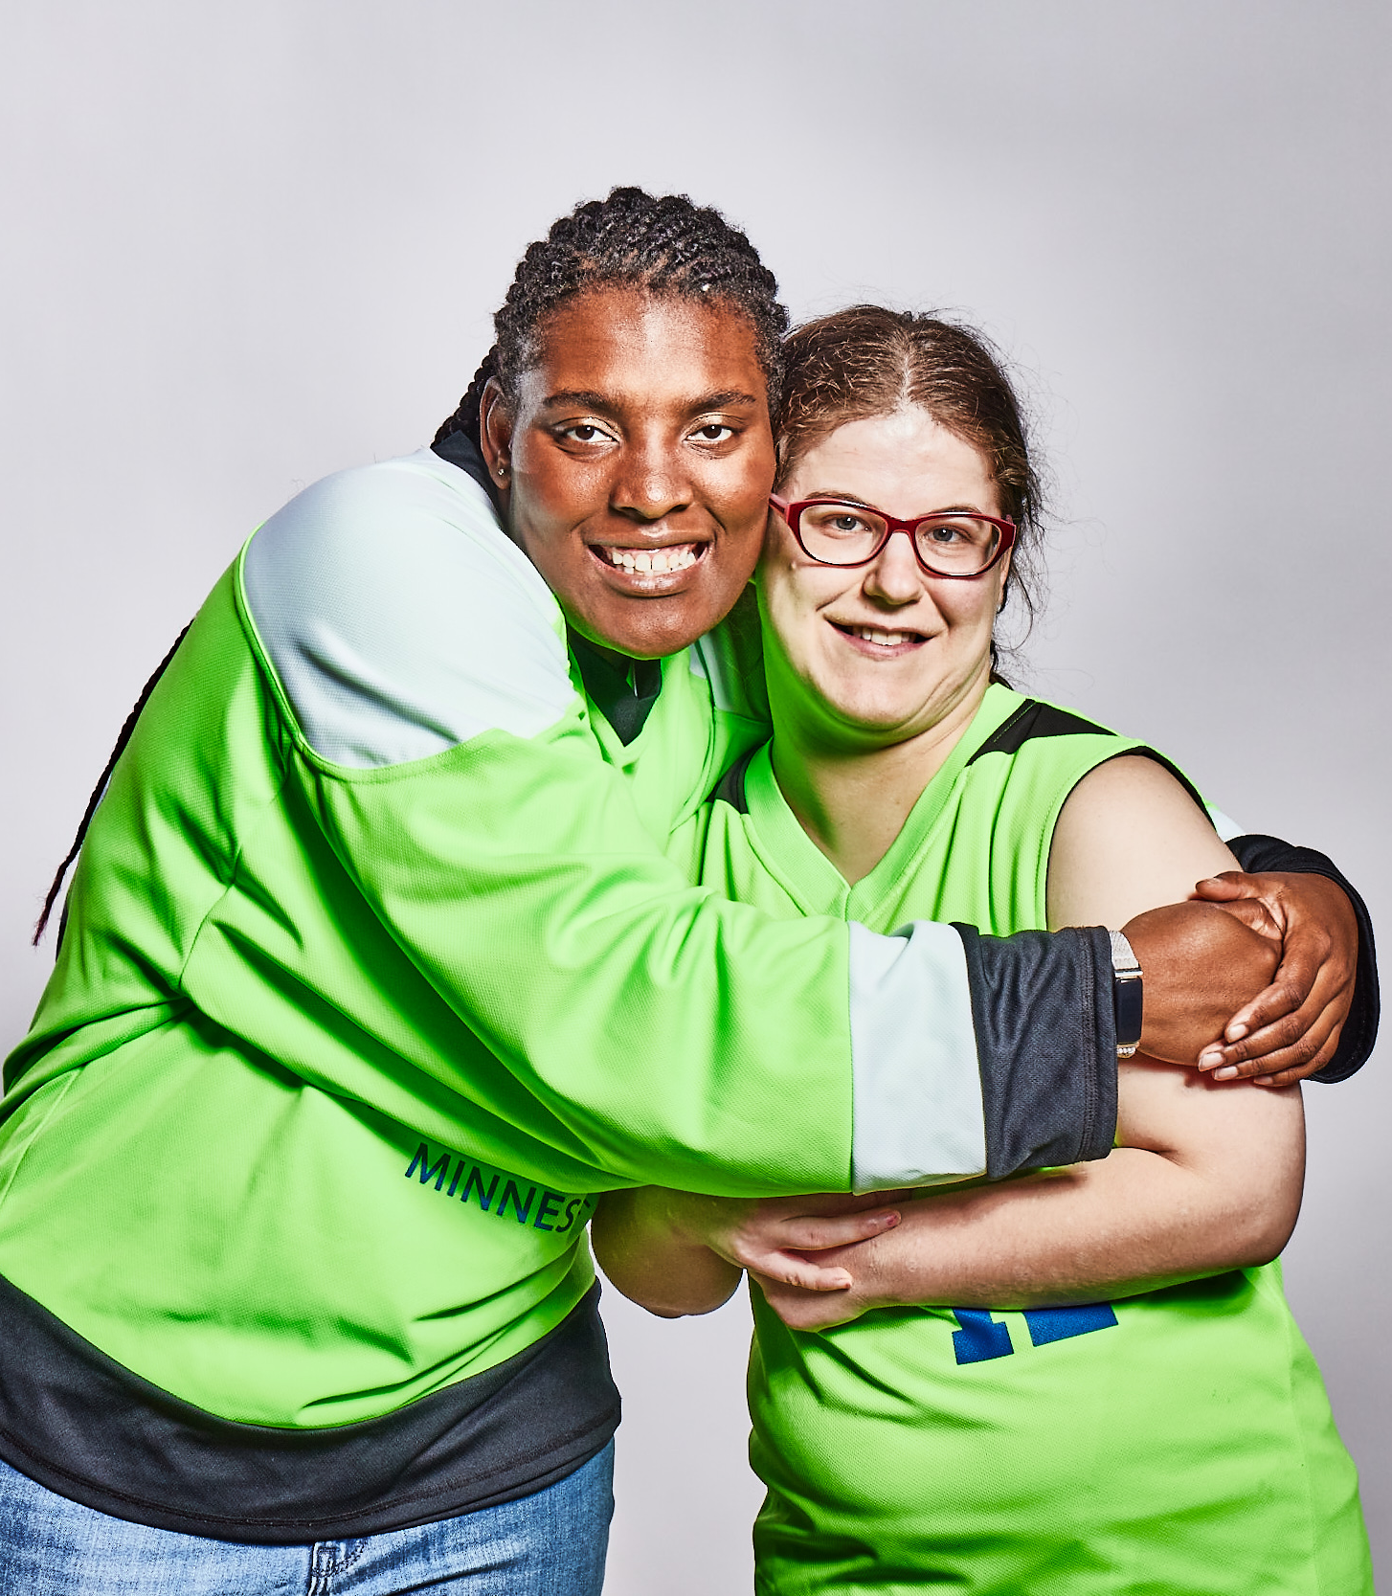
WAYS TO GET INVOLVED
WITH SPECIAL OLYMPICS
Coach
Team Assistant
Unified Partner
Event Volunteer

Slide 9

JOIN THE INCLUSION REVOLUTION
GET INVOLVED
Learn more at somn.org

